Slide 1
Finding Hidden Revenue &
Overlooked Marketing Gems

Slide 2
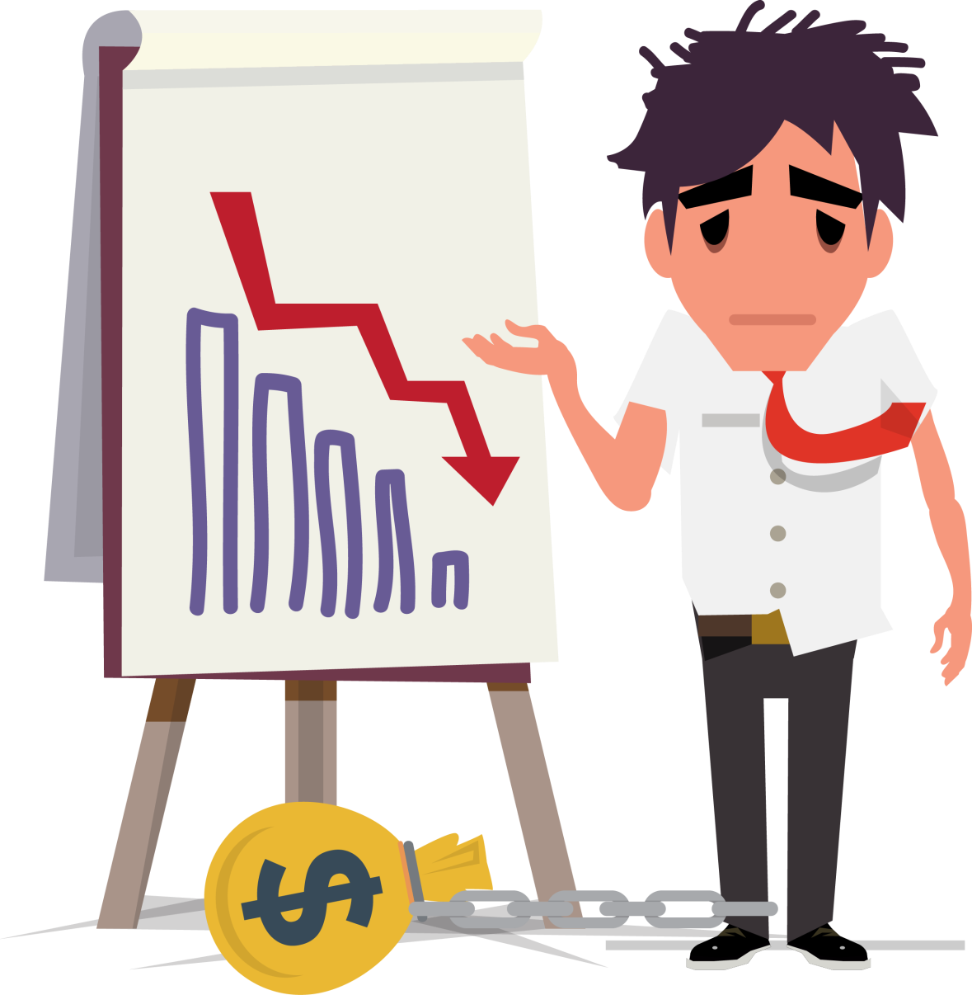
You try your best
Sales remain flat
You work harder and longer every day
What the answer?

Slide 3
Don't overlook what's right in front of you!
Differentiate your product or service.
Find your special niche and promote it!
Be better or different.

Slide 4
Same product or service can have different markets
Different markets need different approaches
Market Segmentation
Divide and conquer!
Zero in – narrow the target

Slide 5

Why keep things the same?
Times change, customers change, markets change
Revitalize your products and services
Create something different or delete something old
Add a "new twist“ to increase sales!

Slide 6

Concessions
Business is not always black and white
Make concessions, when necessary, to:
Satisfy loyal customers
Attract new ones
Who just might one day before loyal customers!

Slide 7
Value-Added Services
Don't stop with a basic sale
Upsell with add-ons
Determine what complements your product or service
Extended warranty
Follow-up support
Discount on supplementary items

Slide 8

Referrals
Use referrals to grow your business
Ask satisfied customers for referral names
Get permission
Contact prospective customers
Word-of-mouth advertising
Great source for new business
Cost effective!

Slide 9

Hear a Complaint – Save a Customer
Complaints are inevitable
Critical factor – How are they handled?

Slide 10

Complaint taken seriously AND handled quickly
Complaint is resolved
Attitude changed... for the better
Complaint brushed off OR postponed (I'll get to it later.)
Creates customer dissatisfaction
Bad comments to others
COMPLAINTS
Which is better for sales?

Slide 11

Underserved Markets
04
Start marketing!
01
Find an underserved market
03
Determine how your product or service can fill the gap
02
Investigate its needs

Slide 12
Tiered Pricing
All pricing does not have to be the same
Different levels of service
Different quantities purchased
Different payment terms
Different warranties

Slide 13

Customize for a Customer
Could be a customized product or service
Could be a customized sales effort
Goal: Close the big one...or a special one
Growth is created with forward momentum!

Slide 14


Revenue Analysis by Category
Do you know?
Gross profit & gross profit percentage by category
Product line
Service line
Department
Where should energies and marketing be directed?
Where not?

Slide 15


PRICING
Optimize pricing based on:
Economic conditions
Quality
Market factors
Competition

Slide 16
PRICING
Anticipated gross profit
What do customers want?
Value
Benefits
Solutions
All things being equal – customers will seek lowest price
Differentiate to command higher prices

Slide 17
Sales Terms
Every sale does not have to include the same terms
Discounts for early payments
Delayed payments for credit worthy customers
Consignment sales
Quantity discounts
Take out on approval
Downpayments and retainers

Slide 18

Internet
Past ≠ Future
Online sales
Social media
Smart phone credit card readers
Don’t be at the back of the pack!

Slide 19

Additional Revenue Streams
What is it? What might it be?????
Complement your existing business
Marginal costs can have big impact on bottom line
Leverage your existing customer base!

Slide 20

Make your product or service the best in its class!
Plenty of room for mediocrity, but
A small space at the top for superiority
That's where success resides!

Slide 21

To Choose or Not to Choose
Customers get to make this choice.
Do business with whom they want to NOT because they have to!
Other businesses most likely have the same products or services.
Remember, few monopolies exist today!!

Slide 22
Inconvenience a Customer
Inconvenience a customer – lose them for life
Inconvenience a customer – make amends – gain them for life
Dinner gift certificate
Small gift
Product or service discount
Pennies out & dollars in – a positive return on investment!

Slide 23

Personal Touch
Customers love feeling important
Take time to make a genuine gesture of concern
Does wonders for customer satisfaction
Watch the positive results!

Slide 24
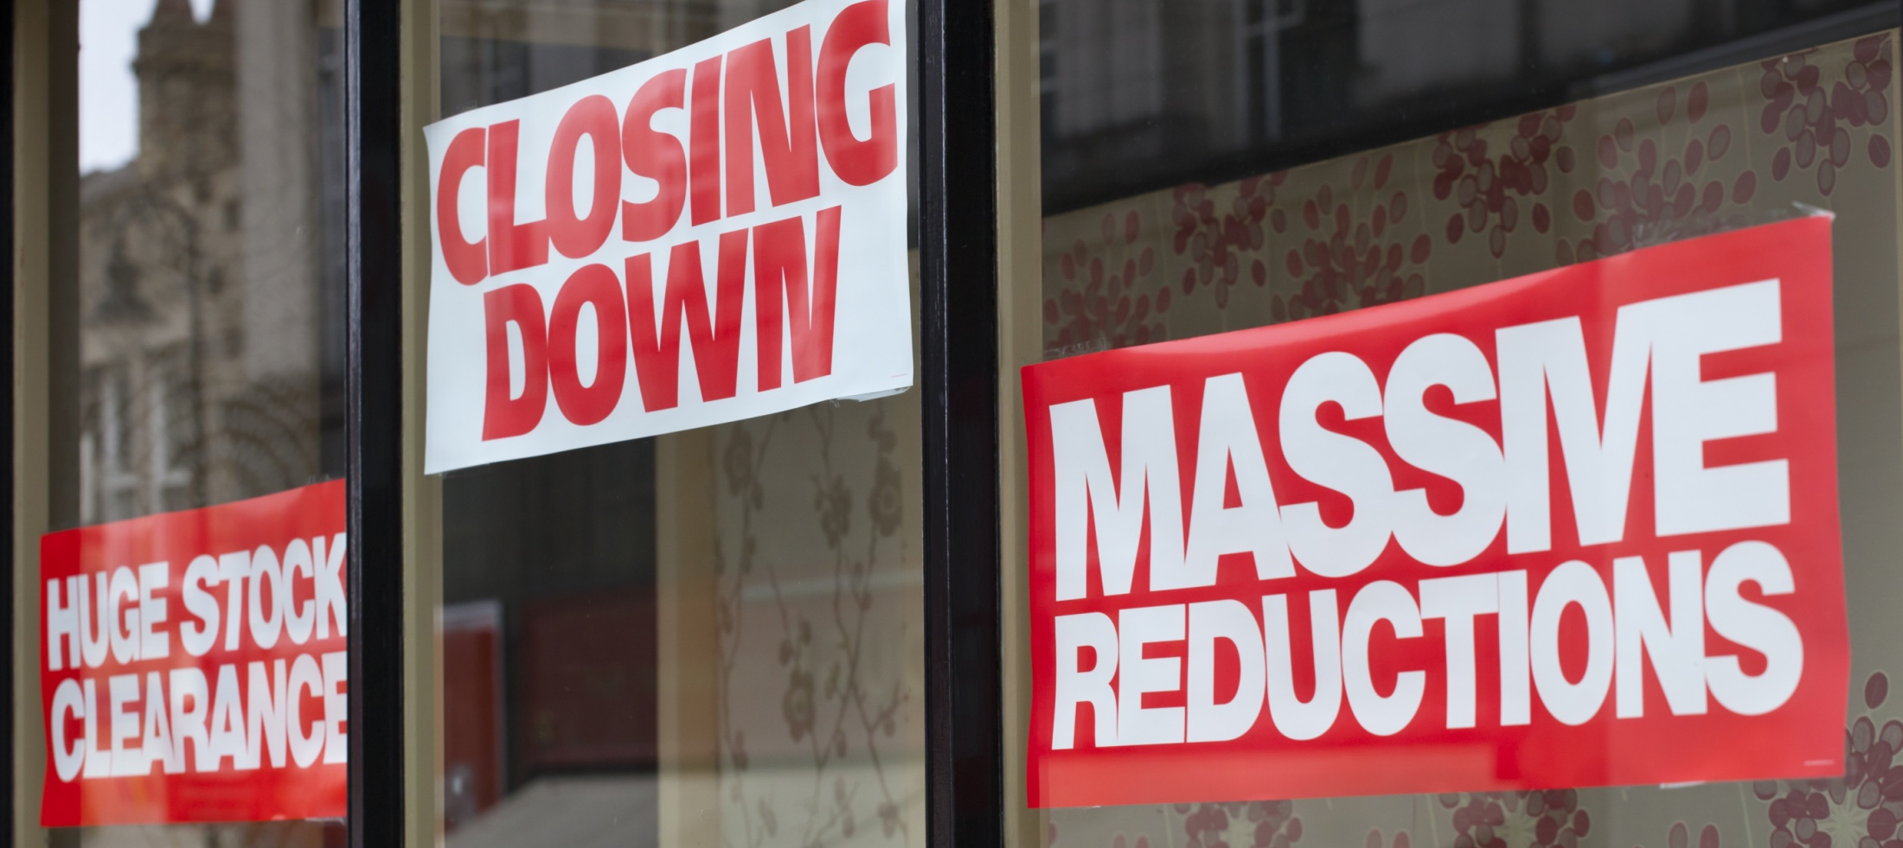
Close the Big One
Can the closing rate be better?
Many times pitch is right, but
Closer is wrong

Slide 25
Close the Big One
Get others involved in the closing
Get fresh ideas on how to close
Get owners or senior managers involved
Demonstrates customer's importance
Customers are impressed
Closing a sale is more important than who closed the sale!

Slide 26

Generate Marketing Ideas
Who's in charge of marketing?
You?
Nothing wrong with this, BUT
Many times new ideas not generated by same person

Slide 27
Generate Marketing Ideas
Involve others
Employees
Customers
Vendors
Marketing firms
Marketing "think tank”
Creative ideas can have startling results!

Slide 28
Marketing Campaign
Hit the target market
Good campaign, but off target – ineffective
Too broad
Directed to more than intended target
Too narrow
Not directed to all of the target audience

Slide 29

Test Marketing Campaign
Determine which component produces most positive results
Change one variable at a time
Search Engine Optimization (SEO)
Website & E-commerce
Pay-per-click (PPC)
TV/radio
Direct mail
Judge revenue impact – See what works best!

Slide 30

Best Hidden Revenue is in Plain Sight
Keep your current customers!!!
Long-term sustainable growth based on:
Customer retention
New customers

Slide 31
Far less costly & time consuming to retain loyal customers than always marketing for new customers
A revolving door of:
Prospects in
Customers out
NEVER leads to sustainable growth!

Slide 32

Insert Name

